Slide 1

EDR A False Sense of Security
Michael Gorelik, CTO
People’s Choice
Award 2016
Cool Vendor 2016

Slide 2
Agenda
Intro to EDR Principals
Intro to MITRE ATT&CK Framework
Methods Used by Attackers to Evade Detection
Demo
Conclusion

Slide 3
EDR (Endpoint Detection and Response) Principals
Visualization
Static scanning
Runtime behavior detection
Response and remediation
Detect
Investigate
Tune
Contain
Remediate
Notes:
To understand how attack works and bypass EDR solutions we first need to understand how EDR works
Endpoint detection and response is an emerging technology that addresses the need for continuous monitoring and response to advanced threats. One could even make the argument that endpoint detection and response is a form of advanced threat protection.
Some EDR perform more operations on the endpoint and some on more on the cloud

Slide 4
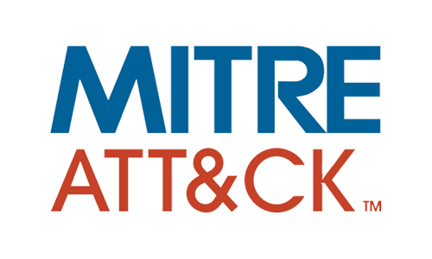
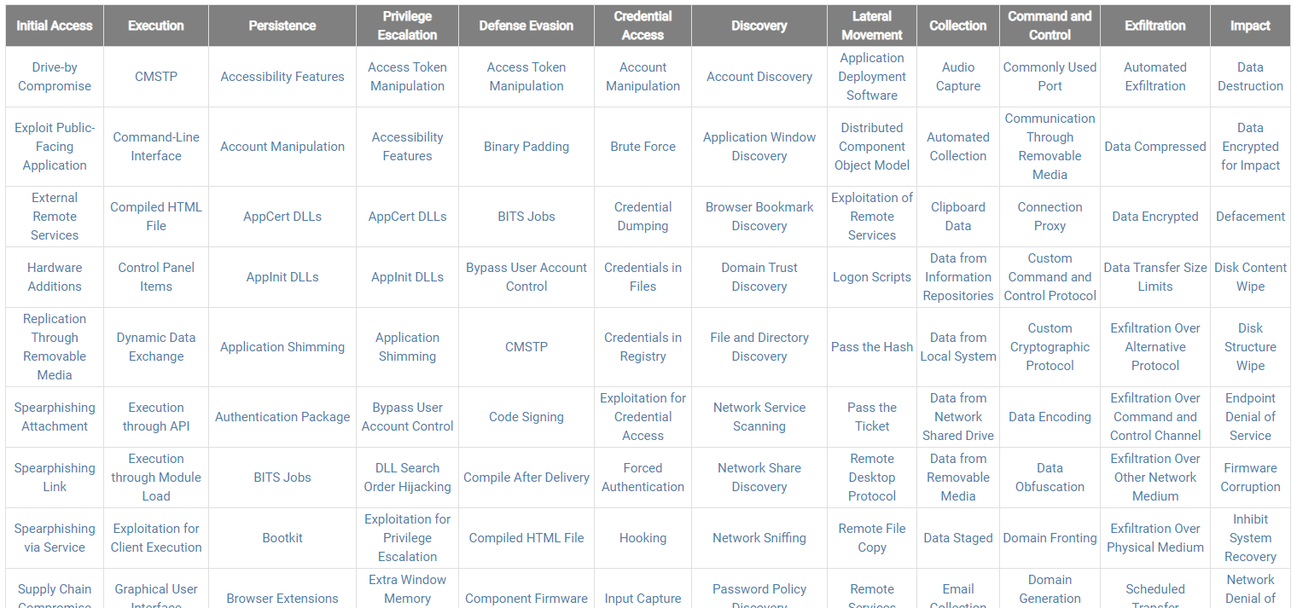
Intro to Framework
Tactics short-term, adversary goals during an attack (column headings)
Eg: Initial Access
EDR Tools Focus On Detecting Techniques Through Behavioral Analysis or Static IoCs
Techniques means by which adversaries achieve tactical goals (individual cells)
Eg: Spearphishing Link
Notes:
New technique are added and identified constantly

Slide 5


Methods Used by Attackers to Evade Detection
Security Technology
Bypass Techniques
Packing and reflectively load self modifying code only during run-time
Introducing noise that can decrease the confidence of many security ML based detection
Behavior Analysis
“Living off the land" – If there is no file on disk there is nothing to scan
Regenerating file signatures and indicators (function names, section names, characteristics, etc.) within seconds; overflowing signature-based static analysis
Static Analysis
Utilizing legitimate applications that have the functionality to execute additional code
Replacing the memory of legitimate applications after loadtime
Whitelisting
Notes:
Adversaries are constantly trying to bypass current mitigation technologies.
Supply chain attacks have been gaining prominence over the years, example of CCleaner

Slide 6
Methods Used by Attackers to Evade Detection
Security Technology
Behavior Analysis
Exploits are Designed to Bypass All Three of These
Static Analysis
Whitelisting
Notes:
Adversaries are constantly trying to bypass current mitigation technologies.
Supply chain attacks have been gaining prominence over the years, example of CCleaner

Slide 7
Total Evasion Attack Chain
Delivery through collaborative platforms
Hollowing (Whitelist Bypass)
Migration / Propagation
Disable Detection
Social Engineering
AMSI & Logging Bypass
Beacon Injection Bypass
Privilege Escalation
Notes:
We will go over each stage – the stages are very typical for today fileless attacks

Slide 8







Delivery Through Collaborative Platforms
Reason
Method
Collaborative platforms become prevalent source for malware delivery as part of: Initial Access, C2, Exfiltration.
As the services are needed for daily routines, those are difficult to block.
Reputation based detection is less relevant.
East to modify within short time without rebuilding the attack infrastructure.
Easy to hide the attack source and hard to attribute.
Widely and freely available – cheaper attack model.
File sharing services
Text sharing
Public storage services
Free email provider services
Cloud instances

Slide 9
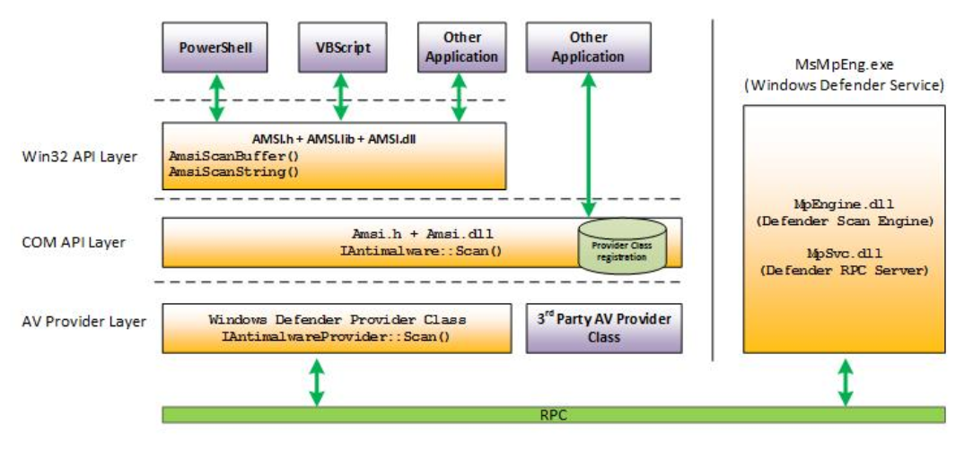
AMSI & Logging Bypass (Antimalware Scan Interface)
Reason
Method
AMSI bypass expected to have a significant role during initial access (first method appeared at 2016).
Obfuscation alone is not enough; attackers need to execute code within the memory without being scanned in runtime.
Amsi bypass:
Patch scanning function -AmsiScanBuffer
Forcing an Error
Run processes without AMSI support – Powershell v2.
Dll hijacking
Logging
Nullify suspicious strings structure.
Patching logging functions (reflection).
Modify policy in-memory
https://www.mdsec.co.uk/2018/06/exploring-powershell-amsi-and-logging-evasion/

Slide 10
Hollowing (Whitelist Bypass) Code injection
Reason
Method
As whitelisting, blacklisting and application control capabilities shifted from being standalone product to being a part of a bigger EPP solution, adversaries started to implement ways to execute the malicious code within whitelisted process.
Hard to block and contain critical processes
Hard to distinguish between the noise of legitimate API execution.
Hard to detect
Code injection
Remote thread
APC injection
Atom bombing
Hollowing
…
Hollowing
Start and suspend a legitimate process
Remap its memory
Resume main thread
Notes:
Why is hollowing difficult to detect? (.Net, Virtualized Application)

Slide 11
Beacon Injection Bypass
Reason
Method
Beacon is the first chunk of code to connect back to the C2 and download the next chunk of code
As part of runtime detection, solutions will scan new injected code just before execution – they may apply static pattern searching or emulation.
Adversaries will abuse operational weaknesses for runtime scanning / emulation
Abusing the weakness that detection solution will not scan the same function
Patch the code with empty statement
Patch it back before next or any other execution.
Emulator bypass
Malicious code will validate the returned values from emulator and abort
Obfuscation
Similar obfuscation as applied to static files can be applied to runtime JITed code

Slide 12
Migration / Propagation
Reason
Method
Having a single backdoor is not enough – as process can crash or being detected
There is the need to disconnect the attack chain so that investigation will lead to dead end and same attack can be reused.
Some processes are favorable as those have more data inside or have more access to other resources
Code injection into popular processes such as: explorer, svchost, dllhost (user session until privilege escalation is achieved)
Execution through exploits
Like the iTunes zero-day identified by Morphisec
Execution through persistency techniques: task scheduler, registry
BitPaymer group replaced the ransomware instead of GoogleUpdate.exe and let the task scheduler execute it.

Slide 13
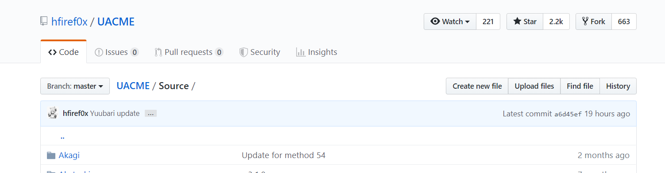
Privilege Escalation
Reason
Method
In most cases privilege escalation is a must step for an adversary
With higher privileges it can disable security solutions
Migrate to system and critical processes
Propagate within the network
Hide and delete traces
UAC bypasses is a type of privilege escalation utilized by most malwares today and requires the user to be an admin.
Those are difficult to patch as those are usually architectural weakness – there are known bypasses even for the latest Win10
Usually composed from set of legitimate steps – while detection solutions are monitoring those steps – those are usually very easy to bypass with simple re-ordering and noise introduction.

Slide 14
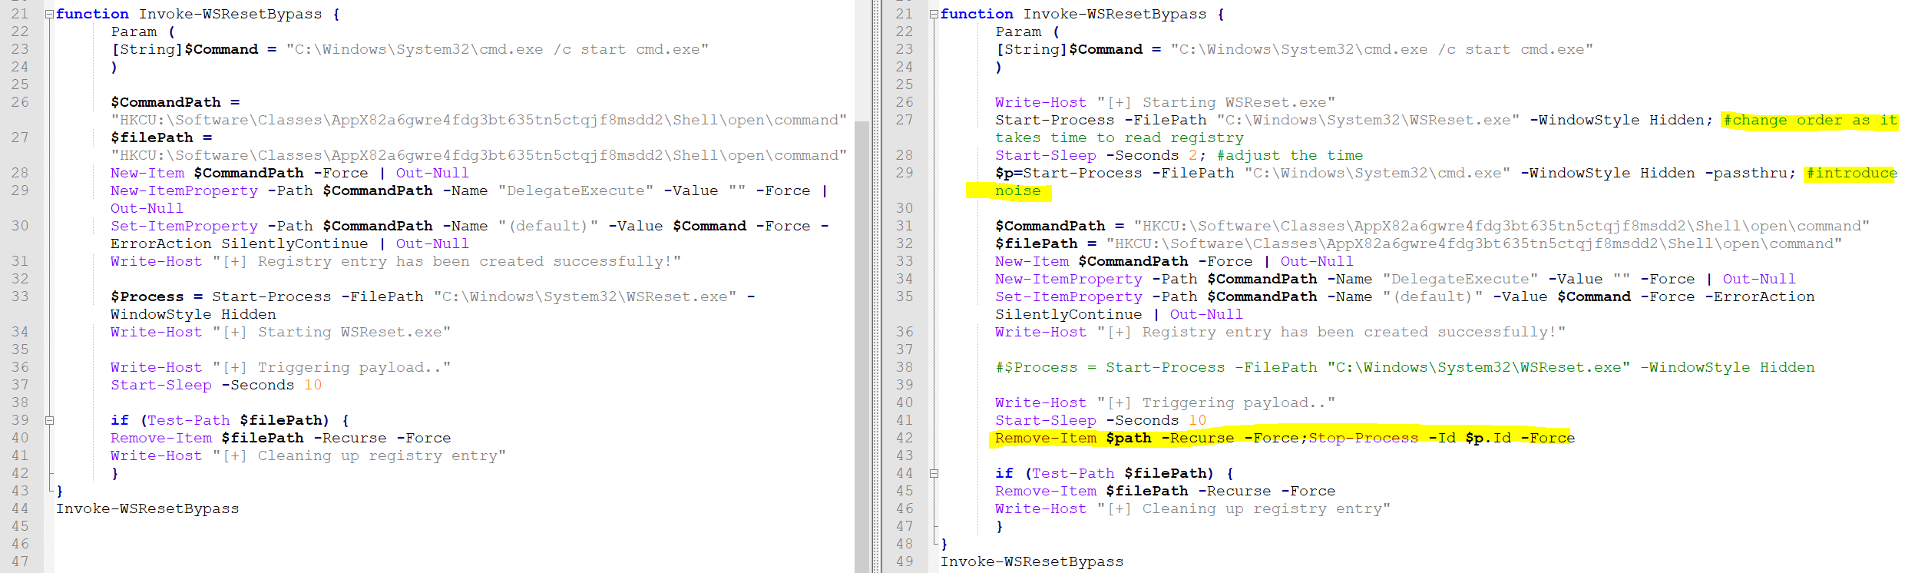
Privilege Escalation Bypass (Win10 1903)
Example1

Slide 15
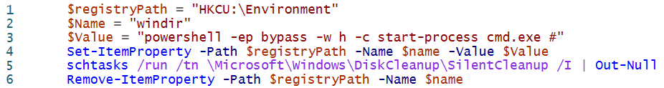
Privilege Escalation Bypass (Win10 1903)
Example2

Slide 16
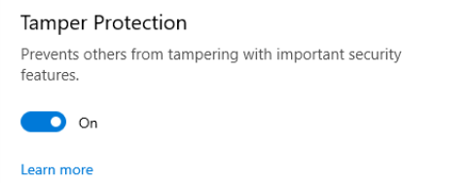
Disable detection
Reason
Method
Adversaries would like to utilize and reuse existing tools without re-inventing the wheel
1-4 hours from first infiltration are critical to the attacker, detection and monitoring tools may become a time critical barrier.
PowerShell API
Service Control
Registry
Driver
Blocking Network , updates, functionality
Exploitation
Dll hijack
Man-in-the-middle
Notes:
Tamper protection is good step forward

Slide 17
Demo Time

Slide 18
Q
&
A

